Slide 1
Ellington’s Bar
The Bistro & Bar jazz club you didn’t know you needed.

Slide 2
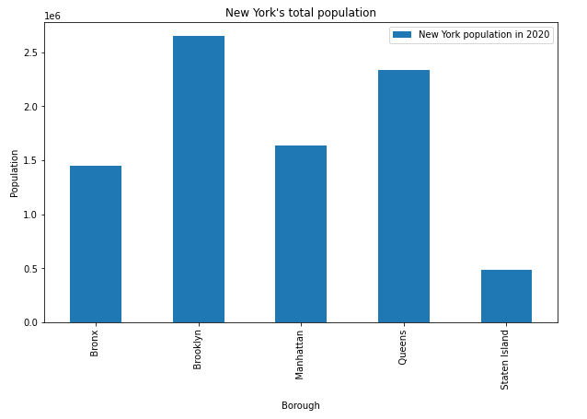
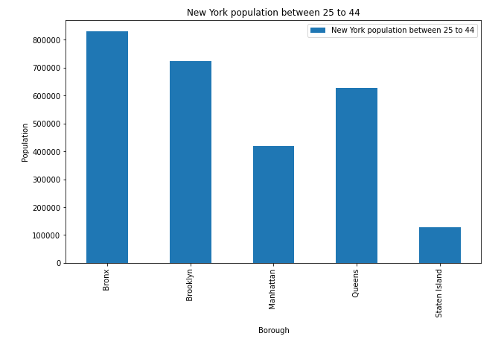
Borough Population
New York has a big population and according to some investigations the target customer for a bistro & bar restarurant is between 25 to 44.

Slide 3
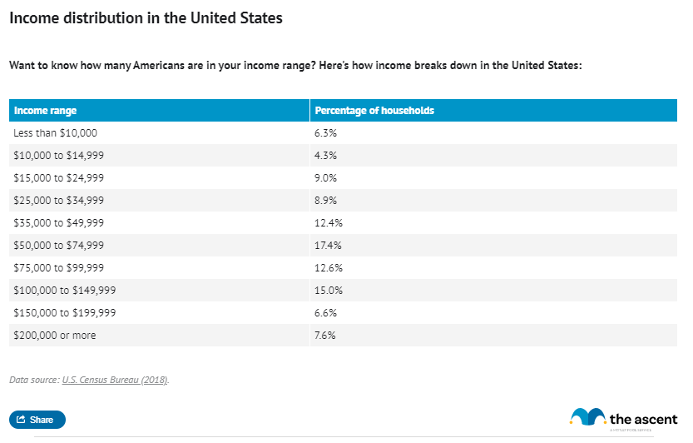
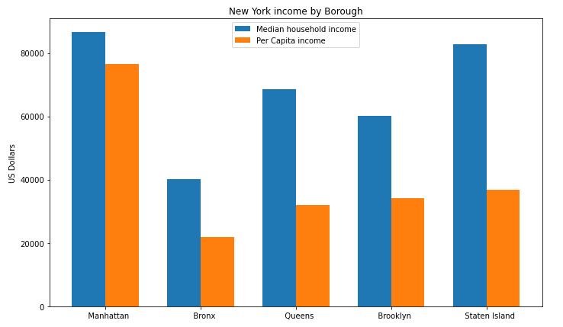
Borough Incomes
According to an article published in the ascent the average U.S income was $87,864 while the median household income was $61,937 in 2018. By taken this into consideration only Manhattan with $86,553, Staten Island with $82,783 and Queens with $68,866 are above the average.

Slide 4
Borough Costs
1
that Brooklyn and Queens have the highest costs for the Building Permits with costs of $6,802 and $5,840 as opposed to Manhattan and Staten Island with costs of $1,896 and $408.
2
In terms of rent all the boroughs are around the same price with the Bronx being the lowest one with a Median Gross rent of $1,212 and Manhattan with a Median Gross rent of $1,740.

Slide 5
Borough Venues
Jazz Club
Piano Bar
Mexican Restaurant
Paella Restaurant
Sushi Restaurant
Steakhouse
Café
Seafood Restaurant
Bar
Bistro
Cocktail Bar
Gay Bar
Wine Bar
Whisky Bar

Slide 6
BROOKLYN
After analyzed several factors such as population, income, costs and venues I have conclude that the best borough would be Brooklyn. This decision is based on several factors.
One is that Brooklyn has the second biggest concentration of the target customer.
Brooklyn may not have the highest salary of all the boroughs but is still near the median household income average and is the category in which a high group of Us citizens also are (17.4% of all US population).
In terms of rent is in the same range as the other boroughs however Brooklyn has the highest cost for the building permits.
For all the boroughs of New York, only in Brooklyn is found a neighborhood that has a jazz club as its most common venue, as well as having the highest number of bars with a total of 78, besides having the highest number of Cafes and Mexican Restaurants.
Notes:
En el modo Presentación con diapositivas, seleccione las flechas para visitar los vínculos.

